Slide 1
Student Loan Forgiveness
Program
GE-139182 (1/19)(1/21)
G549569

Slide 2
Contents
1
2
3
4
STUDENT LOAN BASICS
FORGIVENESS
HOW TO TAKE ACTION!
Q&A
Notes:
Today we are going to cover 4 things – The retirement crisis, our participant experience, plan sponsor experience, and finally share some retirement market insights.

Slide 3
Student Loan Basics:
Types of Loans & Loan Servicers

Slide 4
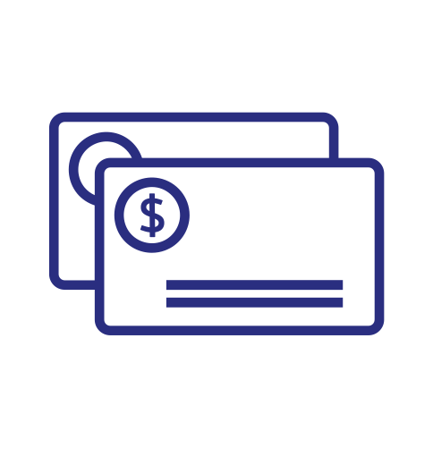
$1.6t Student Loan Debt
$1.2t Auto Loan Debt
$900b Credit Card Debt
Educators with a loan balance of $50k expected to make payments as high as $600/month under a standard repayment plan!
Student Loan Basics: The Problem

Slide 5
Identify Your Loans
Federal
Private
National Student Loan Data System (NSLDS)
Credit Report
Financial Aid Office
Personal Records

Slide 6
Federal Student Loan Programs
Federal Perkins Loan Program
Loans made by banks, guaranteed by Education Department
Direct Loan (DL) Program
Loans made by Education department
Parent Plus Loans
Federal loans made by parents to pay for children’s school
Federal Family Education Loan (FFEL) Program
Loans made by schools
Parent is the “borrower” and liable for repayment
**Only Direct Loans qualify for PSLF**

Slide 7
Based on Income:
Pay as you earn
Income-contingent
Income-based
Based on Loan Debt:
Graduated
Extended
Standard
1
Federal
2
Repayment Plans

Slide 8
Repayment Plans: What Qualifies for PSLF
Qualifies:
Does Not Qualify:
Year Standard
Pays off entire balance and interest in 10 years, typically highest monthly payment option
Graduated Repayment
Starts with small payments, then increases over time
Income-Driven Repayment
PSLF Required (4 types):
Pay As You Earn (PAYE)
Revised Pay As You Earn (REPAYE)
Income-Based Repayment (IBR)
Income-Based Contingent Repayment (ICR))
Extended Repayment
20-to-30-year extended plan, drags out loans for low payments

Slide 9
Forgiveness Plans

Slide 10
Teacher Loan Forgiveness
Plan Requirements:
5 consecutive years of teaching in a Title 1 school
No loans prior to 10/1/1998
Forgiveness Amounts:
Math or science teacher at the secondary education level or Special Education at any level receive $17,500 in forgiveness
Any other subject receives $5,000
Common Issues
Complexity. Many borrowers don’t know this plan exists or enroll incorrectly
Tax filing and increasing income
Parent Plus Loans

Slide 11
Teacher Loan Forgiveness
Plan Requirements:
Borrower must work full time in public service that is nonprofit 501(c)(3), military, public schools, nonprofit hospitals or government
Loan repayment plan type must be one of the four IDR plans or the 10-year standard repayment
120 on-time payments under qualifying payment plans (10-year standard or IDR plans)
Forgiveness Amounts:
Varies from borrower to borrower
No limit on forgiveness and is forgiven tax-free!
Common Issues
Complexity. Many borrowers don’t know this plan exists or enroll incorrectly
Tax filing and increasing income
Parent Plus Loans

Slide 12
How to Take Action!

Slide 13
After You Graduate
Register for your online account with your servicer
Create a budget
Speak with an AXA Advisor Financial Professional to see if you’re eligible for student loan forgiveness

Slide 14
StudentLoan Tech
StudentLoanTech created an iPad app which generates an optimized financial plan incorporating the Public Student Loan Forgiveness Program (PSLF)
The app transforms PSLF into a easily understood program while making it easy to optimally enroll and ensure the borrower follows the correct process.
Improving our clients’ lives
with designed financial
Strategies that reduce the
burden of student loans.
StudentLoan Tech
“
“

Slide 15
Student Loan Forgiveness Case Studies
These case studies are for illustration purposes only. Each individual case will vary.

Slide 16
Q&A

Slide 17
Thank you.
“Equitable” is the brand name of Equitable Holdings, Inc. and its family of companies, including AXA Equitable Life Insurance Company (AXA Equitable) (NY, NY); AXA Advisors, LLC (member FINRA, SIPC); and AXA Distributors, LLC. The obligations of AXA Equitable are backed solely by its claims-paying ability.

